Slide 1
5th International Conference of Faculty of Music 2023 (ICFM-2023)
“Symbiosis of Arts and Cultures: Nurturing Expression, Connection, and Wellbeing”
22-23 November 2023 @ Faculty of Music, UVPA, Colombo, Sri Lanka.
Note: Use the same colors, you may change the font size of the title as needed.
Topic
Name of the Presenting Author* and the Names of the co-authors
With affiliations
Underline the name of the Presenting Author

Slide 2
Outline
Note: use Arial font size 44 for title text throughout the presentation
Introduction
Research objectives
Methodology
Results and Discussions
Conclusion
Acknowledgments
References
Note: use Arial font size 24 for body text throughout the presentation

Slide 3
Introduction
Introduction of your research
Notes:
Folk music traditions are appreciated across the world for their capacity to maintain and convey cultural identities while exhibiting the different manifestations of communities.
According to Karpeles (1955, p. 6), the preliminary definition of folk music established by the International Folk Music Council is "Folk Music is Music that has been submitted through the process of oral transmission."
Folk music, according to Karim (2020), is an essential aspect of art and culture. Acoording to the Kaztuganova Folk music reflects "national ideology", "national language", "national mentality" and "national code" in the era of globalization.
The continuation of a living musical tradition that draws on material from its past and employs the resources and experiences of the past in present musical performances is what the conservation of a musical tradition entails
In the current era of widespread globalization, traditional music may be in danger of being neglected or even forgotten, along with local identities and cultures in general, making the preservation of these traditional music elements one of the most important goals
Folk music is an important part of Sri Lanka's cultural heritage, acting as a rich tapestry that represents the country's customs, beliefs, and varied ethnic populations and it serves as an association between the past, the present, and the future. However, the preservation and conservation of these valuable musical traditions face various challenges in the modern era.

Slide 4
Research Objectives
Objective 1
Objective 2
Objective 3
Notes:
The purpose of this research paper is to investigate and analyze the practices and challenges of folk music conservation in SL. The primary objective is to understand the historical background, current practices, challenges, and potential solutions related to the preservation and promotion of folk music in SL. The specific goals of this research paper include examining the historical origins of folk music in Sri Lanka, analyzing the current conservation practices employed by organizations and individuals, identifying the challenges faced in preserving folk music traditions and exploring potential solutions to ensure the long-term sustainability of these traditions.

Slide 5
Methodology
Methodology
Notes:
This research paper employs a qualitative case study approach to investigate the practices and challenges of folk music conservation in Sri Lanka. Data were gathered using a literature review, semi-structured interviews, and observations. Purposive sampling was used as the sampling method of this study. The collected data were analyzed using content analysis.

Slide 6
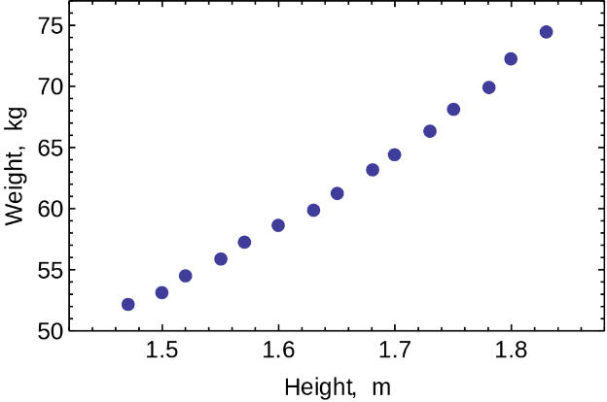
Results and Discussions
Important results
Table.01: (Title)
Note: Use following format for table, image and chart captions. Use Arial font size 20 for captions. Adjust font size in the table body according to the data points count.
Title 01 | Title 02 | Title 03
Data 01
Data 02
Image.01 : (caption)
Figure.01 : (caption)
Notes:
In the 1930s Devar Surya Sena was particularly fond of folk music and folk songs sung by common people. He methodically collected and write down varieties of folk songs such as the harvesting and reaping songs, the fisherman’s songs, vannamas, lullabies, love songs, and children’s songs that describe the people's way of life. After collecting folk songs and Vannamas, he decided to introduce them to the public by conducting concerts. For the first time, Sinhala music was introduced by him into the Church service of Sri Lanka in 1932.
According to the participant, between 1960 and 1970, the Art Council's Gemi gee anumandalaya (Folk Song Committee) gathered and archived folk songs. W. B. Makulloluwa, Ananda Jayasinghe, and C de S Kulatillake were all instrumental in this procedure. Currently, Gemi gee anumandalaya is not available, and instead of that the Arts Council has formed a State Music Advisory Board .
findings stated that the Sinhala Music Research Unit of the Sri Lanka Broadcasting Corporation (SLBC) captured and documented Sri Lankan folk songs and music with the assistance of the Lever Brothers Cultural Conservation Trust funds. C. de S. Kulatillake oversaw this folk song documentation effort.
During the interview, the participant claimed that the Sinhala Music Research Unit is now unavailable and there is no practice of field recording of folk music. According to a participant, the Folk Music Conservation Centre was founded in 2010 under the Ministry of Culture not only to gather and conserve the country's vanishing traditional musical legacy but also for future generations' education and learning. This Centre is presently running well and affiliated with the National Archives and has a large collection of folk music archives.
The C. de. S. Kulatillake Archival & Research Unit of the University of Visual & Performing Arts (UVPA) was founded in 1990 with the primary goal of preserving and continuing materials (Audio Visual Archiving) as cultural heritage. This Kulatillake research center houses a substantial collection of audio and video folk music archives.
Several challenges in preserving and conservation of folk music can be discussed as follows. According to the research, the country did not perform a folk music census and did not preserve a collection inventory. It would have been simple to establish what should be saved first if such an inventory existed. It should also be noted that no specific attention has been devoted to identifying endangered musical genres and pattern approaches. One of the major challenges is the absence of suitable equipment to read the early recorded tapes in archival centers. It was also identified that there is a lack of attention to digitalizing techniques which can preserve sound qualities in early recordings. In addition, there are several conditions to be met in order to store the recorded tapes. However, as a result of poor facilities in the respective centers in Sri Lanka, there is a tendency for recorded tapes to be damaged. Further, most of the recorded tapes are the originals and there are no backup copies of them. Since the recorded materials are on CD and DVD, a preservation procedure should be followed throughout. The lack of necessary resource persons in sound and audio-visual archiving and preservation, lack of awareness in folk music, lack of appropriate programs to strengthen the musicians and improve the taste of folk music among the community and poor financial support result in causing the above-mentioned challenges.

Slide 7
Conclusions
Conclusions of your research
Notes:
The findings reveal that organizations like the Folk Music Conservation Centre, Research and Archive Centers of Universities, Music Research Unit of Sri Lanka Broadcasting Corporation, National Library, and individual practitioners have made significant contributions to the documentation, preservation, and promotion of folk music in Sri Lanka. Their archival work, research initiatives, educational programs, and performances have played a crucial role in safeguarding and perpetuating traditional music forms. Devar Surya Sena, W. B. Makulloluwa, and C. de S. Kulatillake have contributed significantly to the exploration and documentation of Sri Lankan folk music.

Slide 8
Acknowledgments
Acknowledgments

Slide 9
References
Note: Use APA Referencing

Slide 10
References

